Slide 1
Fundamentals of Data Representation Lesson 5
images

Slide 2
Representing data
All data inside a computer is transmitted as a series of electrical signals that are either on or off.
Therefore, in order for a computer to be able to process any kind of data, including text, images and sound, they must be converted into binary form.
If the data is not converted into binary – a series of 1s and 0s – the computer will simply not understand it or be able to process it.

Slide 3
Discussion
In what situations would computers need to store images?
How can computers store images when they can only use numbers?

Slide 4
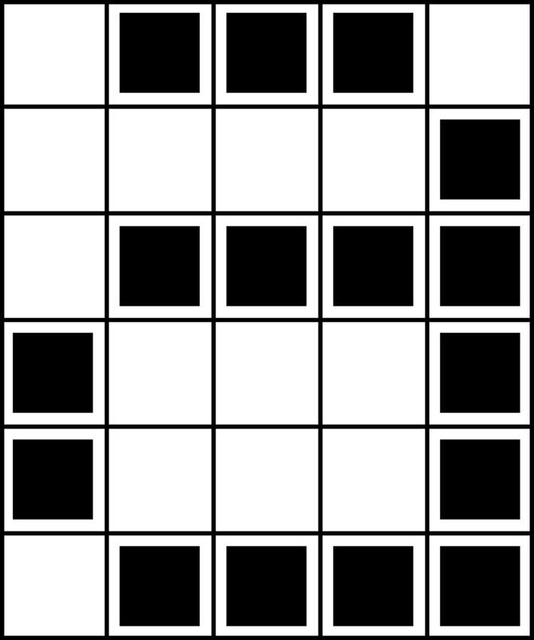
Picture cells
Computer screens are divided up into a grid of small dots called pixels (picture elements).
In a black and white picture, each pixel is either black or white.
Calculating the file size of an image
Size (bits) = Width x Height x Depth
Size (bytes) = Width x Height x Depth/8
The letter “a” has been magnified to show the pixels. When a computer stores a picture, all that it needs to store is which dots are black and which are white.
Picture Cell (PIXEL)

Slide 5
Bitmap
Computers use bits of 1 and 0 to store data.
A bitmap is literally a map of bits that form a particular picture when rendered to a display like a computer monitor.
A bitmap is one of many types of file formats for images stored in a computerised form. It carries the extension .BMP.

Slide 6
Representing images as numbers
Compression
1, 3
4, 1
1, 4
0 ,3, 1
0 ,3, 1
1, 4
 | 01110
 | 00001
 | 01111
 | 10001
 | 10001
 | 01111
If the first number is a zero it will be black
The picture above shows us how a picture can be represented by numbers. The first line consists of one white pixel, then three black, then one white. Thus the first line is represented as 0 for white, 1 for black
Later we will discuss file compression but for now what seems odd about the numbers for the compression above

Slide 7
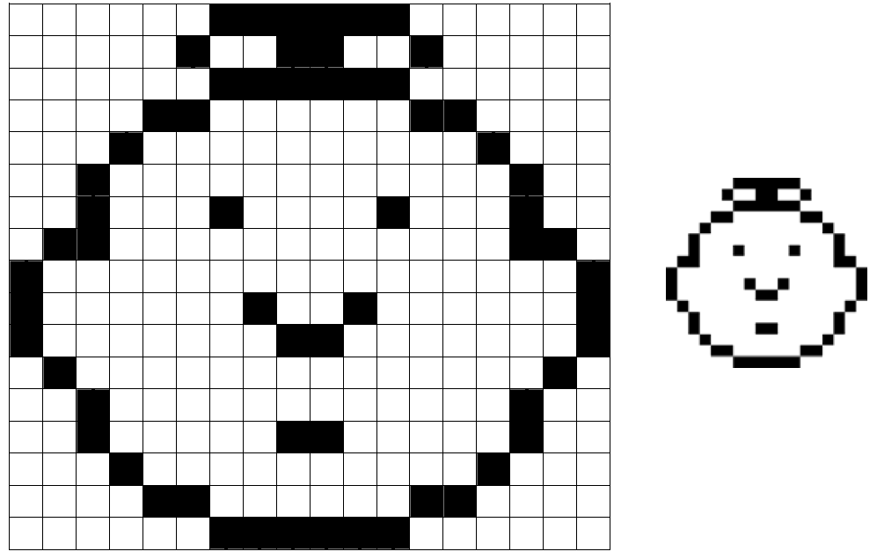
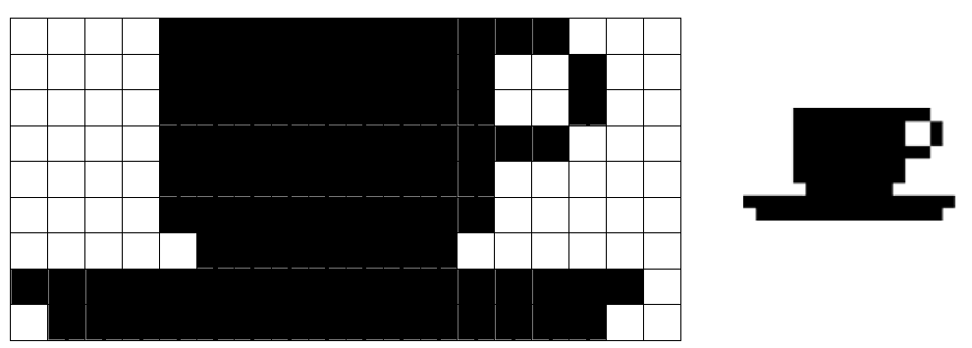
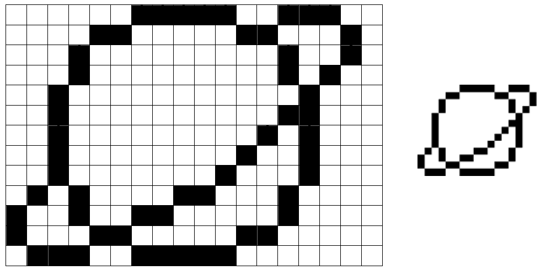
Activities
On the shared drive - called Lesson 5 Activities

Slide 8
Research Task
This is great for black and white images but what about colour images?
Your task!
Describe how a bitmap represents an image using pixels and colour depth, include in your answer how the number of pixels/ colour depth can affect the file size of the bitmap image. Use examples as needed.

